Slide 1
Who’s Doing the Work - Shifting the Lift in Math
Core Advocates Monthly Webinar
September 6, 2017
The webinar will begin shortly. You may wish to download the handouts (check the tab on your webinar control panel) while you wait.

Slide 2
Introductions
Your hosts from the Field Impact Team
Sandra Alberti, Director
Janelle Fann, Project Manager
Jennie Beltramini, Teacher Engagement Manager
Joanie Funderburk, Manager of Professional Learning
This Month’s Guests
Marni Greenstein, SAP Mathematics Specialist
Melissa Higgins, Colorado Core Advocate
Jaimee Massie, Oregon Core Advocate

Slide 3
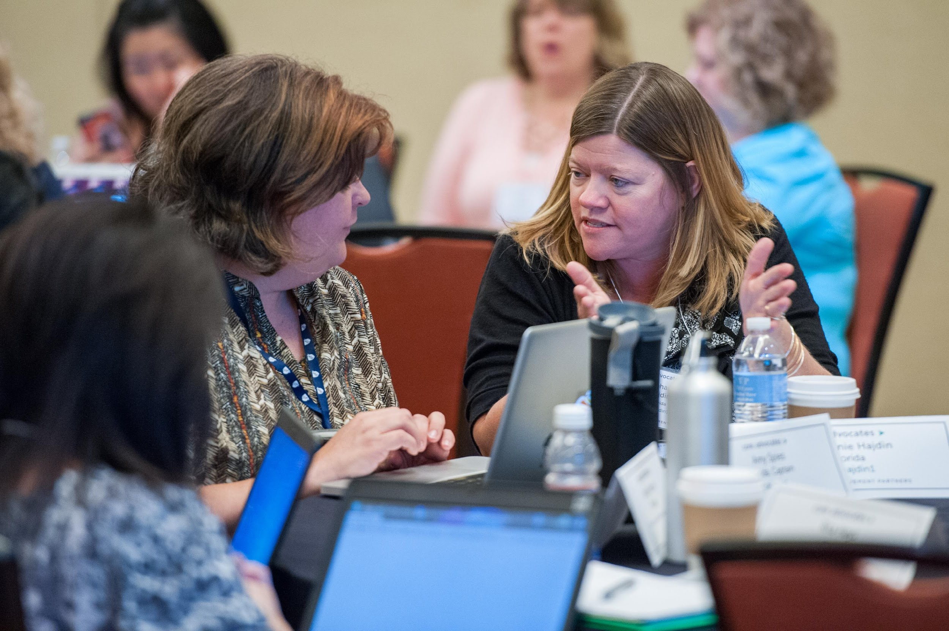
Who are Core Advocates?
Core Advocates are educators who:
  Believe in the potential of the CCSS to prepare all students for college and careers;
  Are eager to support their colleagues and communities in understanding and advocating for the CCSS and CCSS-aligned instruction;
  Understand and embrace the shifts in instruction and assessment required by the CCSS
Notes:
The Core Advocate webinar series was born to extend and support the Core Advocates program, and the chance to help teachers implement changes in their classrooms – give very brief info on CA here

Slide 4

To learn more about Core Advocates…
Contact Jennie Beltramini (jbeltramini@studentsachieve.net ) or Joanie Funderburk (jfunderburk@studentsachieve.net)
Complete this survey to join our database (and mailing lists): https://achievethecore.org/ca-signup
Visit our website: www.achievethecore.org

Slide 5

Tweet with us
Please feel free to tweet during and after the webinar using #coreadvocates
@achievethecore
@JoanieFun, @salberti, @JennieBeltro
@math_marni
@jaimeemassie

Slide 6
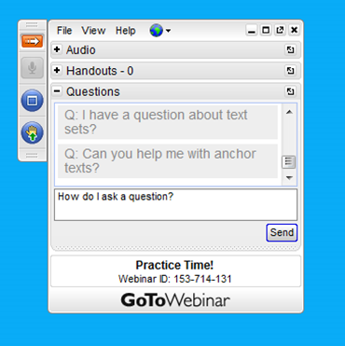
Webinar protocols
During the webinar
– Accessing Documents
– Questions option
– Polling
After the webinar
– Survey
– Access to recorded webinar

Slide 7
Instructional Advocacy – A Definition
Grounded in a firm understanding of the Shifts, educators owning, supporting, and promoting the resources, tools, and practices that create learning environments in which students develop college- and career- readiness.

Slide 8
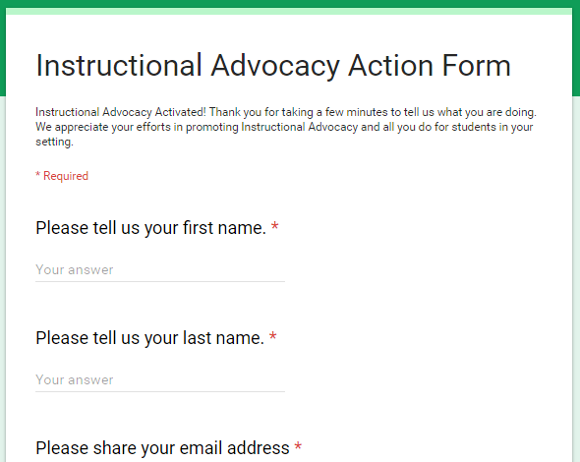
Tell us about your efforts
www.achievethecore.org/educators-taking-action

Slide 9
Goals of the webinar
Learn how the Instructional Practice Guide identifies the components of a math classroom where students are engaged with and learning mathematics
Recognize what it looks like when students are holding the majority of the cognitive lift in a math class
Consider adjustments to instruction that shift the cognitive lift back to students

Slide 10
How does the Instructional Practice Guide (IPG) help teachers understand and create a classroom where students are actively engaged in meaningful mathematics?

Slide 11
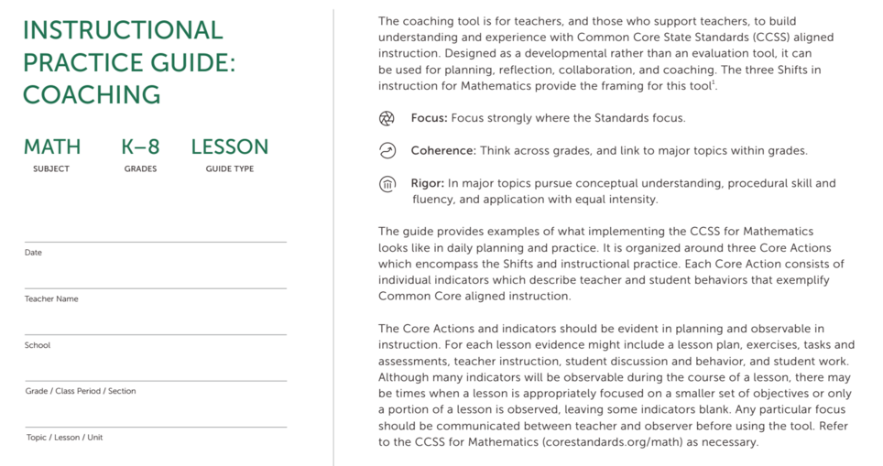
The Instructional Practice Guide: Coaching
Notes:
Big Idea:
This slide allows for an overview of the IPG.
Talking Points:
Here you see a screenshot of first page of the document
Individually, please take a few moments to review the document structure and features.

Slide 12
Core Actions in the IPG
Core Action 1: Ensure the work of the lesson reflects the Shifts required by the CCSS for Mathematics.
Core Action 2: Employ instructional practices that allow all students to learn the content of the lesson.
Core Action 3: Provide all students with opportunities to exhibit mathematical practices while engaging with the content of the lesson.
Notes:
Big Idea: Share the Core Actions that the IPG names for observing CCR-aligned instructional practice
Details:
We will be taking a look at a specific tool for observing CCR-aligned instructional practice. This tool names three overarching Core Actions that indicate alignment.
Each of these Core Actions has more detailed descriptions of what to look for, but they will serve as a frame for us throughout our work today or analyzing a lesson observation, lesson plan, and student work.
You will notice that both Core Actions 2 and 3 reference “content.” It is important to remember that, as we look at teacher actions and how the practices play out in the classroom, they are all in service of students learning the specific mathematical content of the grade.
Background Knowledge:
Note to Facilitator:
If participants are new to the IPG Coaching Tool, you may want to provide an opportunity for them to highlight key words within each indicator (both from the indicator and rating language.) One way to do this is to have everyone highlight the keywords for Core Action 1 and discuss as a full group. Then have smaller groups do something similar with 1 or 2 indicators (highlight key words as well as think of examples and non-example of this indicator). These could be shared on posters and discussed with the full group.

Slide 13
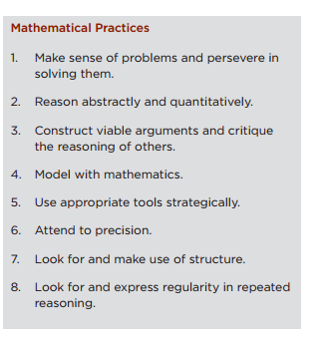
Standards for Mathematical Practice
Core Action 3:
Provide all students with opportunities to exhibit mathematical practices while engaging with the content of the lesson
Notes:
Big Idea:
This slide provides explanation for why all eight math practices do not appear in Core Action 3.
Talking Points:
Many teachers know that there are eight standards for mathematical practice in the Common Core State Standards, and that this means there is not a one-to-one correspondence in indicators in Core Action 3.
As stated on the slide, the intent of the IPG: Coaching is to focus on the math practices that are most easily observable during instruction.
The lack of one-to-one correspondence is not intended to imply that some math practices are more important than others, or than some can be disregarded by teachers.
Students should be presented with opportunities to exhibit the mathematical practices in relation to the content of the lesson on a daily basis.
Background for Presenter (if needed):

Slide 14
Core Action 3: Provide all students with opportunities to exhibit the math practices while engaging with the content of the lesson.
Indicator A:
The teacher poses high-quality questions and problems that prompt student to share their developing thinking about the content of the lesson.
Students share their developing thinking about the content of the lesson.
Notes:
Big Idea:
This slide illustrates the components of Core Action 3, including teacher behaviors, student behaviors, and possible rankings.
Talking Points:
Note that the structure of Core Action 3 is different than that of Core Action 2.
Here, each of the indicators has two parts – one that describes the teacher behaviors and one that describes the student behaviors.
Because this Core Action is about the math practices, we need to consider both teachers and students.
Teachers are responsible for creating the classroom structures and opportunities for students to engage in the math practices. Students have to actually engage in them.
The language in the scale allows an observer to rank the degree to which the indicators are present during the lesson.
Note also that scale is also different from the ones in Core Actions 1 and 2.
The language for the 1-4 ratings are the same for every indicator in Core Action 3.
At the top end of the scale, the teacher is providing opportunity consistently and most students are demonstrating the behavior associated with the indicator.
On the opposite end of the scale, the teacher fails to provide opportunity and very few students demonstrate the given behavior.
In preparing to rate the indicators for Core Action 3, evidence should be gathered that illustrates both the teacher actions and student behaviors, which will lead to a more accurate rating for each.
Students should be presented with opportunities to exhibit the mathematical practices in relation to the content of the lesson on a daily basis.
As shown in the footnote, not every indicator will be evident in all lessons that are taught and observed. However, some or most of the indicators should be observable. In the case where an indicator is not observed in a lesson, it should be left blank.
Background for Presenter (if needed):

Slide 15
Poll:
Which indicator(s) in Core Action 3 lead to students “doing the work” in a math classroom?
Notes:
Select all that apply:
A - Teacher uses high-quality questions and tasks
B - Teacher offers opportunities for productive struggle
D- Students are encouraged to talk about each other’s thinking
F - Students explain and justify their work
All of these!

Slide 16
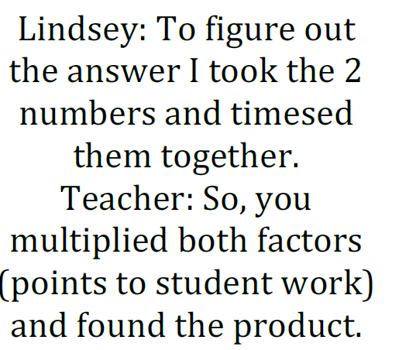
Evidence for Core Action 3 Indicators
Notes:
Big Idea:
This slide Introduces the Core Action 3 card sort activity.
Talking Points:
Table groups (3-6 teachers per group) will get a set of cards.
Review the activity instructions on the slide, pointing out that the purpose of the activity is not to place all the cards or to place any cards “correctly,” but rather to foster conversation about the indicators and how they might play out in classrooms.
Be sure your whole group is discussing the same card at the same time, and be sure to share your voice and perspective in the conversations
Possible debrief questions:
Write your own! There are blank cards in your card set - feel free to add your own teacher or student descriptor for one or more of the indicators in Core Action 3.
Which card was the hardest for your group to place? Why?
How did the student and teacher cards and the discussion your group had add clarity to the meaning of the indicators of Core Action 3?

Slide 17
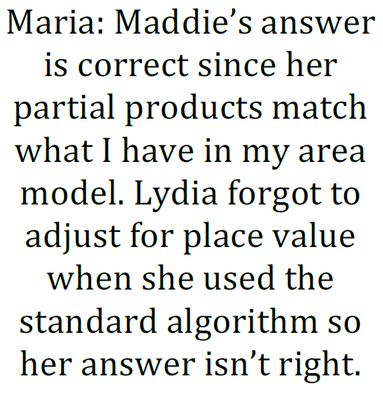
Evidence for Core Action 3 Indicators
Notes:
Big Idea:
This slide Introduces the Core Action 3 card sort activity.
Talking Points:
Table groups (3-6 teachers per group) will get a set of cards.
Review the activity instructions on the slide, pointing out that the purpose of the activity is not to place all the cards or to place any cards “correctly,” but rather to foster conversation about the indicators and how they might play out in classrooms.
Be sure your whole group is discussing the same card at the same time, and be sure to share your voice and perspective in the conversations
Possible debrief questions:
Write your own! There are blank cards in your card set - feel free to add your own teacher or student descriptor for one or more of the indicators in Core Action 3.
Which card was the hardest for your group to place? Why?
How did the student and teacher cards and the discussion your group had add clarity to the meaning of the indicators of Core Action 3?

Slide 18
Evidence for Core Action 3 Indicators
Kaleb: I noticed that in each row of the metric table the number on the left is ten times as much as the one on the right, that’s like our base ten system. It’s 10 times more each time we shift a place left.
Notes:
Big Idea:
This slide Introduces the Core Action 3 card sort activity.
Talking Points:
Table groups (3-6 teachers per group) will get a set of cards.
Review the activity instructions on the slide, pointing out that the purpose of the activity is not to place all the cards or to place any cards “correctly,” but rather to foster conversation about the indicators and how they might play out in classrooms.
Be sure your whole group is discussing the same card at the same time, and be sure to share your voice and perspective in the conversations
Possible debrief questions:
Write your own! There are blank cards in your card set - feel free to add your own teacher or student descriptor for one or more of the indicators in Core Action 3.
Which card was the hardest for your group to place? Why?
How did the student and teacher cards and the discussion your group had add clarity to the meaning of the indicators of Core Action 3?

Slide 19
What does it look like when students are holding the majority of the cognitive lift in math class?

Slide 20
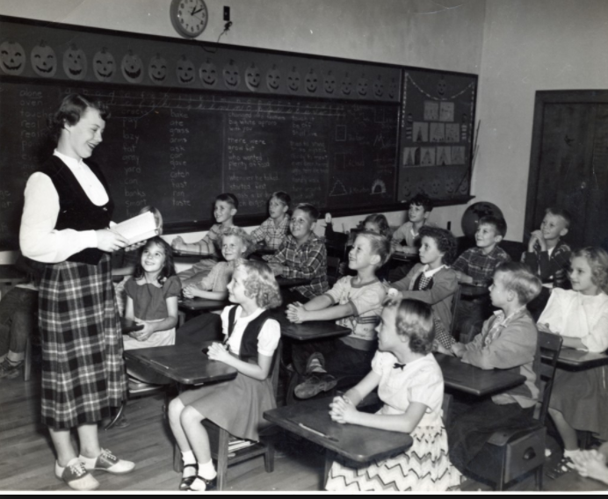
Student engagement
“The culture of American schools, in its deep structure, is very teacher-centric. We tend to focus more on what the teacher is doing in front of the classroom than we do on the work that is actually on top of the student’s desk.”
Richard Elmore, “Improving the Instructional Core”
Notes:
Many of us experienced math class passively, with a teacher talking and explaining at the front of the room, and students listening (hopefully), and perhaps copying down anything the teacher wrote on the board. In many classrooms across the country, this continues to be the norm, with research supporting the extensive use of teacher-lecture math classrooms, particularly in middle and high school.

Slide 21
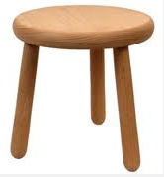
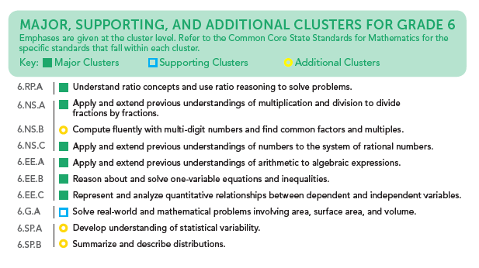
Shifting the Lift for Math Worth Doing
Application
Conceptual Understanding
Procedural Skill & Fluency
Notes:
In the era of CCR standards, the opportunity for students to engage meaningfully with important mathematics is increasingly important. We know that a balanced approach, with equal emphasis on conceptual understanding, procedural skill and fluency, and application is required, and that students’ deep understanding of the major work of the grade is crucial to their success in math across the grades. When considering the most important mathematics at each grade level, we want to be increasingly sure that we are shifting the lift and ensuring that students are engaged in active learning.

Slide 22
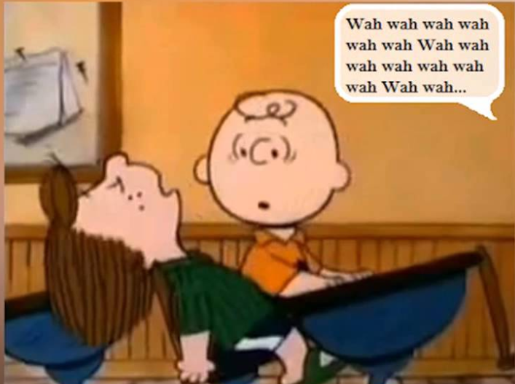
Talk Time
“When I was in front of the class demonstrating and explaining, I was learning a great deal, but many of my students were not! Eventually, I concluded that if my students were to ever really learn mathematics, they would have to do the explaining, and I, the listening.”
Steven C. Reinhart, “Never Say Anything a Kid Can Say!”
Notes:
We’ve all been in classrooms where the teacher does all of the talking and the students do all of the listening. As Reinhart suggests here, the person doing the majority of the talking in the classroom is likely also doing the majority of the learning! This issue is even more problematic in classrooms where students are historically low-achieving. Flanders (1970) reported that teachers of high-achieving students spent about 55 percent of the class time talking, compared with 80 percent for teachers of low-achieving students.
During my 20 years as a classroom teacher, I found this article, published by NCTM, one of the most helpful for addressing my tendency to do all of the talking!

Slide 23

Responding to Struggle
“A focus on student struggle is a necessary component of teaching that supports students’ learning of mathematics with understanding. Teaching that embraces and uses productive struggle, leads to long-term benefits with students more able to apply their learning to new problem situations.”
NCTM’s Principles to Actions; p. 48
Notes:
No teacher likes to see students struggle, and many of us have seen (or have BEEN) teachers who jump in to help as soon as students experience any sort of difficulty. It’s uncomfortable and can be unpleasant, and our very nature as teachers is to want to make it easier and more pleasant on our students! We know, however, that productive struggle is an important and necessary part of students’ learning of mathematics. In Principles to Actions, NCTM includes “Supporting productive struggle” as one of its eight math teaching practices, and data proves that this kind of struggle has long-term benefits for students and their learning. It’s not about struggle for struggle’s sake, it’s about the right kind of struggle at the right time and in the right amounts, and connected to the right mathematics that results in high levels of student learning.

Slide 24
Question:
As you reflect on a recent learning experience, what means of engagement best supported your learning?
Please use your Questions tab to respond.

Slide 25
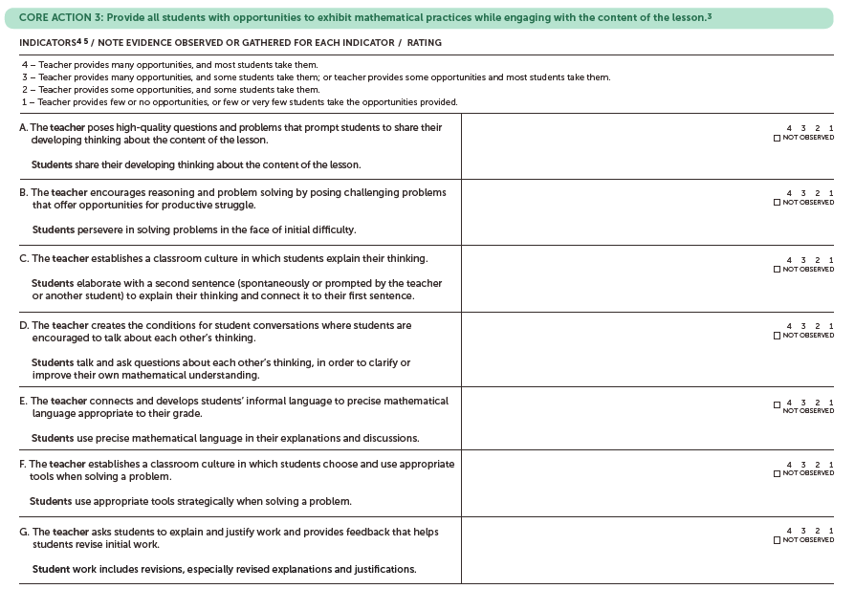
Data Collection:Instructional Practice Guide Core Action 3
Notes:
Before a teacher can address the issues of students owning the cognitive lift, he or she first must have a sense of what’s currently happening in the classroom. Just like teachers start where students are at and build from there when teaching new content, teachers can start where they currently are and improve practice from there.
First you will need to determine what method or methods to use to collect the data, as well as which tool or tools to use to assess the current state of student engagement.
If you are a classroom teacher, or work with a classroom teacher interested in assessing how much of the cognitive lift your students are owning, a method of data collection you may consider is having a peer or coach observe, or a you could simply record yourself on video or audio and review what is happening in the classroom without bringing someone else in. Core Action 3 of the Instructional Practice Guide is an excellent resource for this kind of review, allowing the teacher or observer to identify the indicators that are or are not at work within a classroom or lesson.
When I was a teacher and used this tool, I reflected on video of my teaching and noticed indicator B was a strength, students were doing lots of explaining and justifying their own work, but D was something I knew I could work on, promoting more conversation and student reflection on their peers’ work.

Slide 26
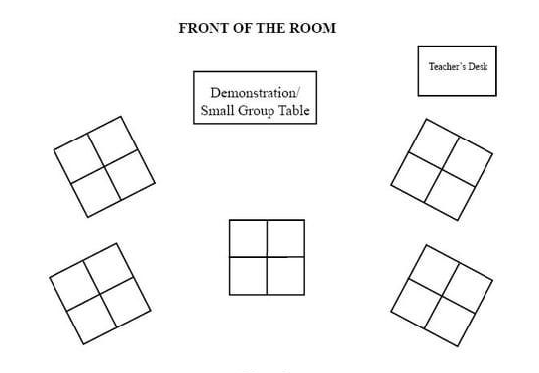
Data Collection - Who’s Doing the Work?
Teacher Talk Time % Teacher Talk
Student Talk Time % Student Talk
Teacher Questions/Responses
Student Questions/Responses
Notes:
If a teacher is looking for more specific data about student engagement, other tools could also be helpful. Simply tracking the amount and percent of time during the class that the teacher is talking and that the students are talking, or using a seating chart to track teacher-to-student and student-to-student interactions could provide useful information. Or, the questions asked by the teacher and by the students could be evaluated, as could the responses to the questions asked. These could be recorded by a coach or peer, or recorded on video or audio. A teacher could gain better insight about their own patterns of behavior, including those that are unintentionally taking the thinking away from the students.

Slide 27
What instructional practices can be used or adapted to shift the cognitive lift to students?

Slide 28
Question:
What obstacles do teachers face in shifting the lift in math to students?
Please use your Questions tab to respond.

Slide 29
Common obstacles
Teachers feel pressed for time - it’s faster and easier to use direct instruction to cover content.
Teachers and students are uncomfortable with struggle.
Teachers and students want the satisfaction of students being able to obtain right answers to math problems.
Teachers and students have beliefs about students’ abilities to understand and/or engage with math (all students or certain subgroups).
Teachers and students think math instruction is being told the rules or procedures and engaging in rote practice.
Teachers are uncomfortable with student activity that isn’t carefully controlled.
Notes:
As we’ve been saying throughout the webinar, we know that teachers are not intentionally taking the cognitive lift away from their students! We know that all teachers believe that students need to engage with mathematics to learn. We also know that teaching is a complex and difficult task! Oftentimes the issues we struggle with in our classrooms are having the unintended consequence of negatively impacting students’ authentic engagement with math.
We appreciate your responses to the question about obstacles, and we made a list of those we find common in our experiences in our own classrooms and in working with other teachers. Here are some of the most common ones.
(I’m not sure how we want to have them revealed or if you want to talk about each one… let’s do some thinking on that.)

Slide 30
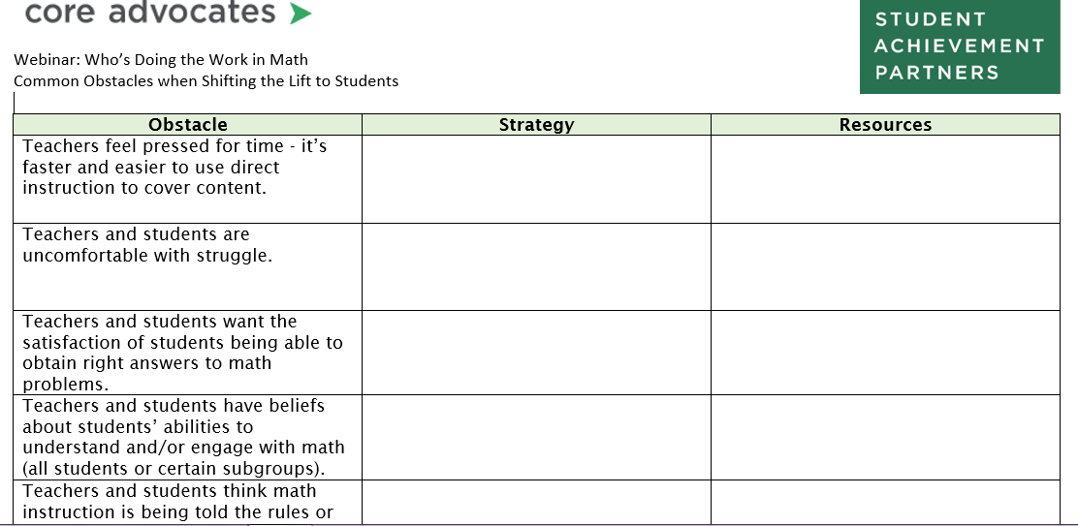
Adjustments that shift the cognitive lift to students

Slide 31
Obstacle: Teachers feel pressed for time - it’s faster and easier to use direct instruction to cover content.
Strategy | Tools/Resources
Use FOCUS to ensure that major content is allowed more time and attention. | Focus by grade level documents
Use COHERENCE to ensure that mathematical connections are made explicit. Tie new concepts to those previously learned. | Coherence Map
Select high-quality tasks that help students understand the math and its connections to other concepts. | Tasks on Achieve the Core and Illustrative Mathematics
Notes:
It’s important to acknowledge that these obstacles are real, and consider strategies for addressing the concern in ways that support student learning, rather than taking the high-levels of thinking out of their hands.
Handout
In order to address the time issue, for instance, teachers could use the Shifts of FOCUS and COHERENCE to ensure that they are allowing the most time for the most important mathematics, and ensuring that as students engage with the major work of the grade, the connections to other math concepts is made explicit in their work. These connections not only help reduce the amount of time students may require to make sense of the math, they also allow for students to better understand and better remember the mathematics from one lesson, one week, one month, and one school year to the next. It does take more time to go more deeply into the math, so it’s important that teachers are strategic about spending more time on the right math and in the right ways. You can find tools on Achieve the Core to help teach with Focus and Coherence, such as the Focus by grade level documents and the Coherence Map.
High-quality math tasks can also help teachers with instruction around major concepts of their grade and how it connects to other important content. There are tasks that do this on both Achieve the Core and on Illustrative Mathematics’ website.
(I will hotlink all of the resources)

Slide 32
Obstacle: Teachers and students think math instruction is being told the rules or procedures and engaging in rote practice.
Strategy | Tools/Resources
Provide structures (such as collaborative groups, think-pair-share, shoulder partner talk, etc.) to provide safe ways for students to share their developing mathematical thinking. | Creating Math Talk Communities Number Talks Never Say Anything a Kid Can Say! article
Intentionally sequence sharing of student work to show the development of a mathematical idea. | 5 Practices for Orchestrating Productive Mathematics Discussions
Utilize incomplete and/or partially correct student work to honor and celebrate mistakes as learning opportunities | Mistakes Grow Your Brain Mathematical Mindsets
Provide feedback and create the expectation that students revise their work. | Rough Draft Talk in Math
Notes:
One of the challenges we know many teachers face is simply a lack of experience with a student-centered style of teaching. Many of us experienced math instruction with a teacher at the front of the room providing definitions, rules, processes and examples that we were expected to copy down and parrot back. We often weren’t given the opportunity to share our thinking or to work deeply with other students on a rich task. This type of instruction is common in math classrooms at all grade levels across our country, and often it is the only kind of math instruction our students have received. Lack of experience with students owning the cognitive lift is a struggle for teachers and students alike!
As teachers, we may need to create space for our own learning of new strategies that can support our students. We will need to try out and refine classroom strategies that encourage students to take more ownership and responsibility for their learning, and help them to get comfortable with this if they aren’t used to it in math class. There are lots of resources to help math teachers engage students in talking about their mathematical thinking, such as Sherry Parrish’s Number Talks books and articles available on NCTM, but even simple routines like “Think-Pair-Share” or use of partners and collaborative groups, or even just providing a few moments for students to write down a response before being asked to share their thinking with others. Along with shifting the lift instructionally, teachers may have to do intentional work around creating safety for students to make mistakes, and how to honor them and use them as teachable moments. Additionally, setting the expectation that students will revise, refine, and rework their mathematical work helps to shift the cognitive lift to students.

Slide 33
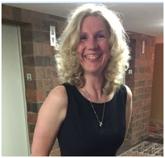
Special Guest Core Advocate:
Melissa Higgins
7th Grade Math Teacher
Murphy Creek P-8, Aurora, CO

Slide 34

Belief that ALL students can access the learning
Teacher’s actions demonstrate belief that “ALL” students can
Teachers identify students’ strengths and use those to set next steps
Teachers use content that supports students’ strengths

Slide 35
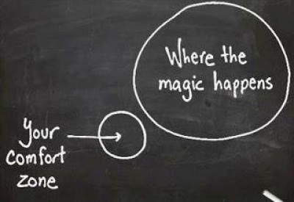
Leading by Example: Risk taking by letting go of control of the learning
Teachers have to model risk taking to support students taking risks
Teachers have to allow students to own the learning in order to encourage risk taking
Teachers have to be comfortable with the unknown

Slide 36

Balancing time needed to understand and still cover the content
Moving slower to allow
for conceptual understanding
leads to speed with
procedural skill and fluency
Quality versus Quantity
Depth of Knowledge vs.
covering year at a glance/pacing
guide

Slide 37
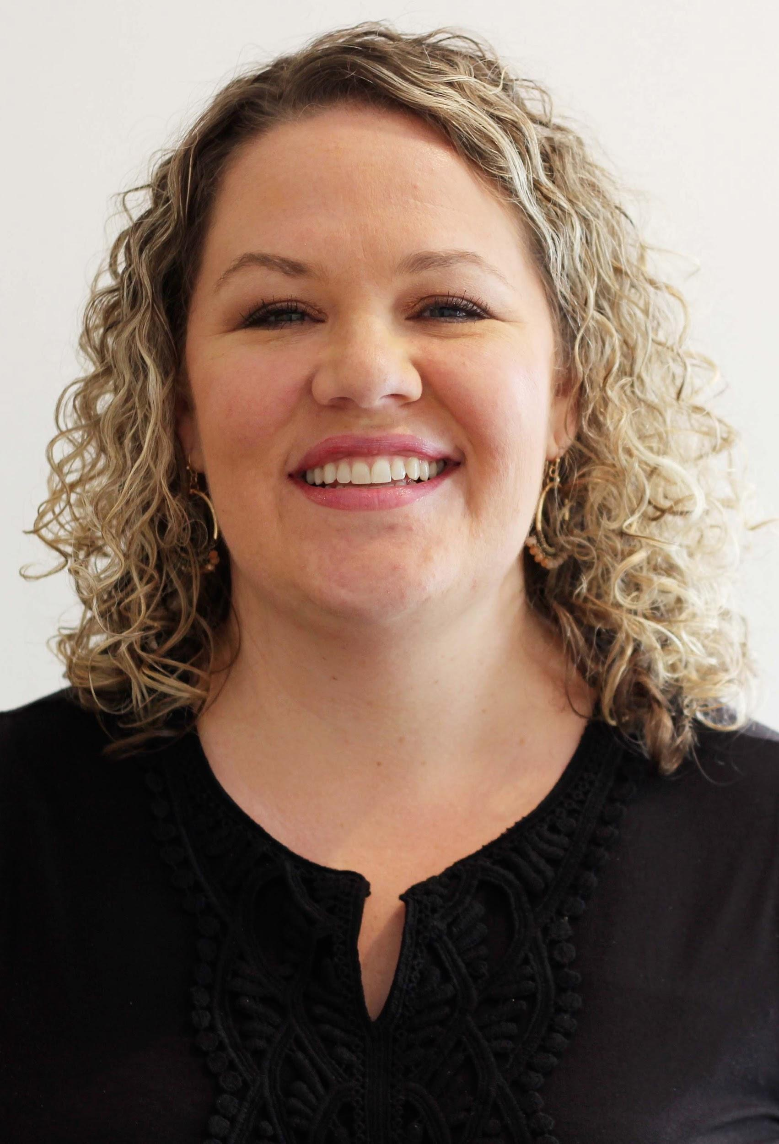
Special Guest Core Advocate:
Jaimee Massie
Elementary Math TOSA
Eugene 4J SD, Eugene, Oregon
Notes:
Brainstorming note… Some obstacles we’ve/I’ve faced: (I chose the bold but I can cut down or revise any)
fear of letting students struggle
too much content to cover and this way of teaching takes time
teachers waiting or re-teaching to master each procedure or concept rather than using coherence to bridge
forgetting to create an intentional environment where wrong answers are new roads to explore rather than failure or the end
Interventionist example - relationship building - card games and routines, take risks now to leverage later
forgetting to review or set up protocols for student sharing and intentional linking between these examples
gradual release to student to student discourse
doing the math - anticipating student strategies & keeping them from year to year
being able to leave a problem or concept un-finished (wonder wall)
brainstorming or planning for accessibility rather than making a problem/task/concept easier
reading to the whole class or student
asking clarifying or focusing questions before launching to group or independent work
building prior knowledge around concept, context or vocabulary
planning to elicit thinking from a variety of learning styles (whiteboards, pairs, gallery walks, sentence stems to response

Slide 38

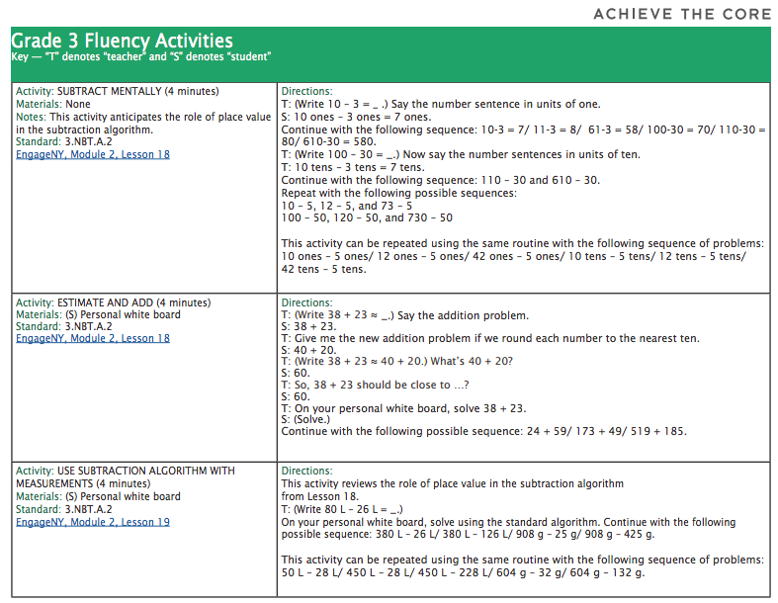
Safe Risk-taking to Build an Intentional Math Community
Form relationships
Play games
Set up routines
Acing Maths
Notes:
I think the most important part of this work as we shift the lift is to make sure our students trust us and that they learn to trust each other.
We talk about developing a safe and caring community. How does this roll over into math and what specific moves are taken to ensure teachers can leverage this? We always start our year in Title with card games. If we have the opportunity to play them in multi-aged grouping then all the better. Kids will take risks and learn to listen to each other. You get a window into how kids handle failure when they lose. Kids get to develop relationships when its safe to take these risks. I can be intentional about the routines I begin to set up and prompt sharing of strategies, talk about math practices and mindset, and then move to more obvious math routines like Number Talks or entry grade-level tasks. We can fall back into these games and routines when I notice the group losing its sense of community or our math gets a little harder than they would like.

Slide 39
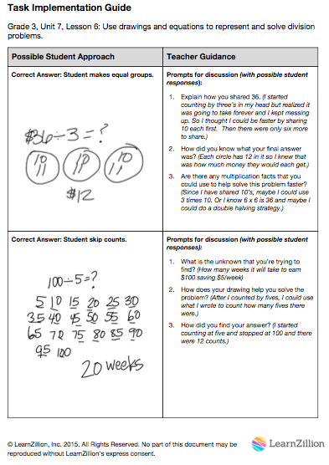

Anticipating & Collecting Student Strategies
Worthwhile task
Do the math
Sequencing system
Collect new strategies
Confer with colleagues
Save for later!
Notes:
Being prepared for the work is key! When you can anticipate student strategies and approaches before your own cognitive load is high, you can select well and keep the focus on the math.
Start with a worthwhile task. Think about the math and then do it like 2-3 types of students in your class (be a kid)!
I used sticky notes with 1,2,3 and then would look for some strategies. They allowed me to change my mind. I would ask kids to think about what they wanted to say and ask questions so I knew they were prepared.
If I saw a strategy I hadn’t anticipated I would add it to my notes. I could meet with my colleagues to talk about what we saw in our rooms. When our math program was new, we did this more often.
Now something I didn’t do but wish I had! A few amazing teachers I know saved their notes and then they didn’t have to work so much out the next year or even on future lessons. They could refer to their strategies list/notes. Brilliant!

Slide 40
Maybe it’s not the math, maybe it’s access
reading to the whole class or student
asking clarifying questions before launching to group or independent work
building prior knowledge around concept, context or vocabulary
get out the tools
planning to elicit thinking from a variety of learning styles
  whiteboards
  use think-pair-share
  gallery walks
  sentence stems to response
share mid-way not only at the end
Notes:
As I moved into this work, I wanted to keep the math rigorous but their were a series of worries… there are too many words, my kids can’t read, some of them don’t want to share, how do I get them sharing when they can revise their thinking rather than as a closing thought
Working with younger kids and then students with the most unfinished learning in our Title program, I started to formalize the ways I could give access to the math without all these excuse to lower the rigor.

Slide 41
Questions for webinar guests?
Notes:
How do you help a teacher realize that they are not allowing students to own the cognitive lift?
What’s a small first step that I can try? How do you deal with an administrator/observer who doesn’t like to see students struggle?

Slide 42
Set a goal:
As you reflect on the indicators of Core Action 3 of the IPG, set an intention around improving one or more in your own classroom.
What evidence could you collect to measure your progress?
What evidence could you collect to determine the impact on student learning?

Slide 43
Resources
Principles for the Design of Mathematics Curricula: Promoting Language and Content Development
Rachel Lambert – MATHEMATIZING4ALL
Collection of math and disability resources

Slide 44
Instructional Advocacy – A Definition
Grounded in a firm understanding of the Shifts, educators owning, supporting, and promoting the resources, tools, and practices that create learning environments in which students develop college- and career- readiness.

Slide 45
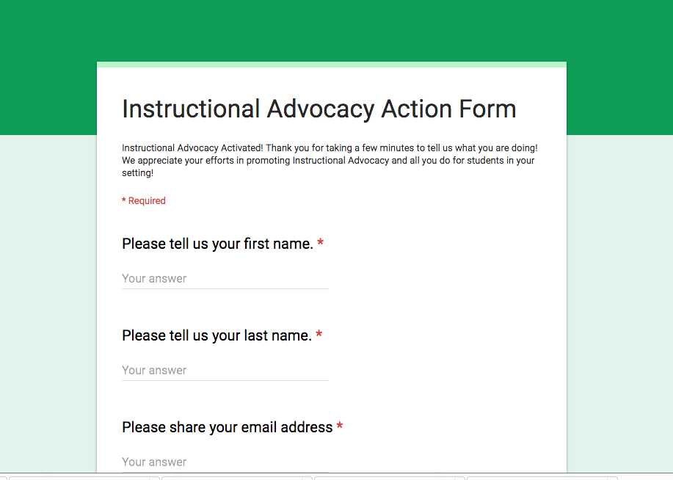
Tell us about your successes
http://tinyurl.com/educatorstakingaction

Slide 46
Please join us again next month!
Next month’s topic:
Who’s Doing the Work: Shifting the Lift in ELA/Literacy
Wednesday, October 4, 2017 7:00 - 8:00 pm Eastern
Register Here: https://attendee.gotowebinar.com/register/7353373621105953539
Notes:
Joanie

Slide 47
Thank You!

